Slide 1
Phone Marketing Algorithm Analysis
PWC analyst: Xiaofu Chen
Last UPDATED: June 11, 2021

Slide 2
Agenda
Model Selection
The best classifier we chose to predict the purchase behavior of bank’s clients.
Feature Importance
The effects of important features in our model from global and specific perspective.
Take-aways
The conclusion of this analysis and the advice for enhance market strategies

Slide 3
OBJECTIVE
Analyze the classification model we created and provide insight into which features influence the outcome of the model the most on a global and specific level.

Slide 4
Model results
Model | Accuracy Score
XGBoost Classifier | 0.9027
Kneighbor Classifier | 0.8918
Random Forest Classifier | 0.8850
Decision Tree Classifier | 0.8452
Logistic Regression | 0.8256
After tuning, XGBoost Model has the best performance.
Notes:
Indicate the when, where, how in the slide of the introduction of dataset

Slide 5
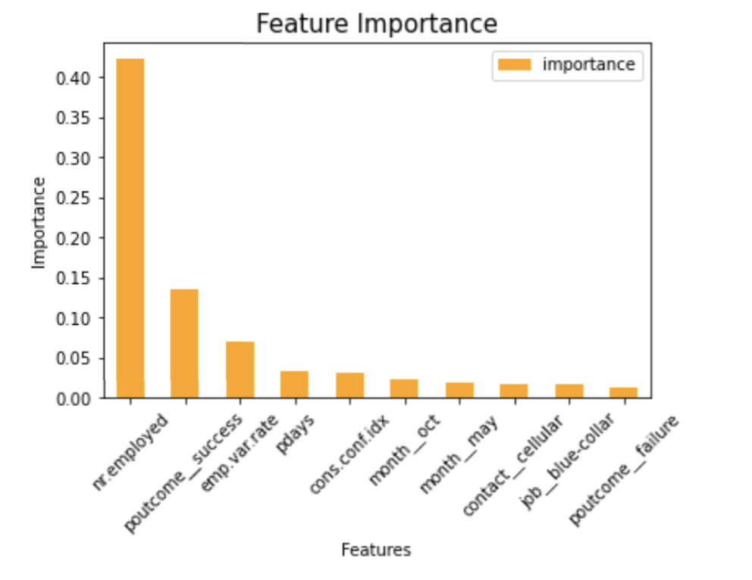
Feature Importance（XGBoost)
nr.employed: the number of employees
poutcome_success: the outcome of the previous marketing campaign is success
Emp.var.rate: employment variation rate (shows importance in all models)

Slide 6
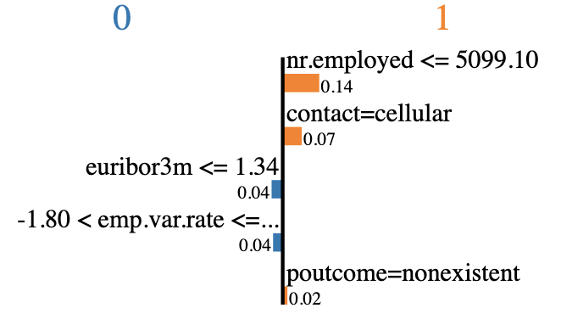
Feature Importance
(For observation #4)
nr.employed: the number of employees
Contact=cellular: contact method is cellular
Euribor3m: euribor 3-month rate
poutcome_nonexistent: the outcome of the previous marketing campaign is not existent
Emp.var.rate: employment variation rate
Prediction result: Yes

Slide 7
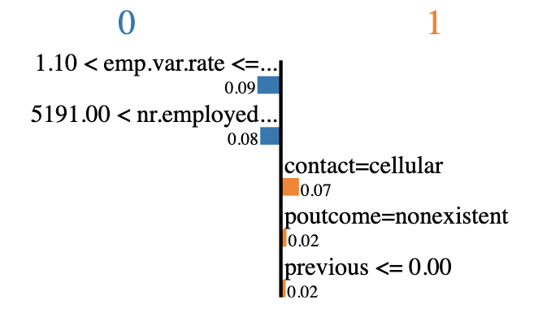
Feature Importance
(For observation #20)
Emp.var.rate: employment variation rate
nr.employed: the number of employees
Contact=cellular: contact method is cellular
poutcome_nonexistent: the outcome of the previous marketing campaign is not existent
Previous: number of contacts performed before this campaign and for this client
Prediction result: No

Slide 8
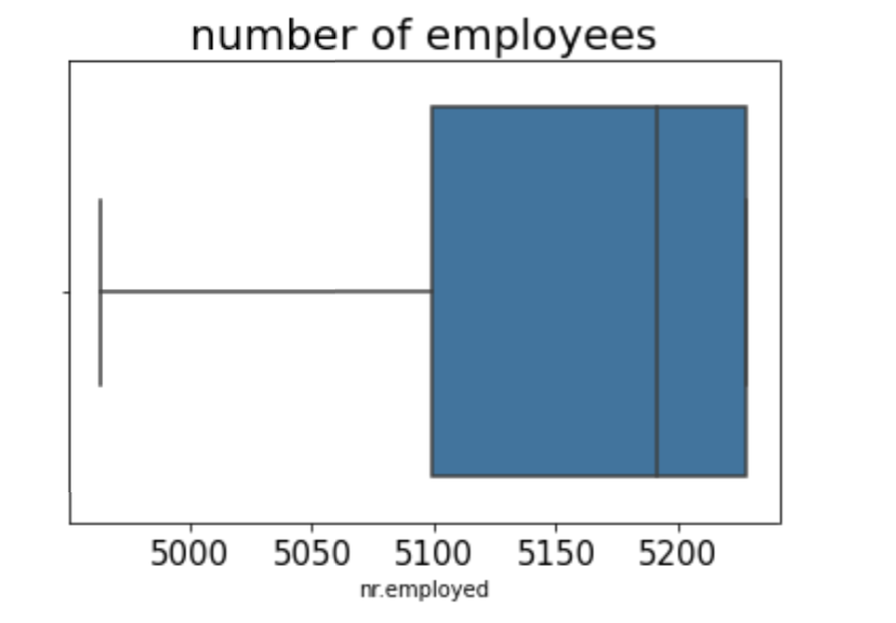
Take-aways
Lower number of employees (<5099) brings positive impact in the model.
However, the mean number in our dataset is 5167.

Slide 9
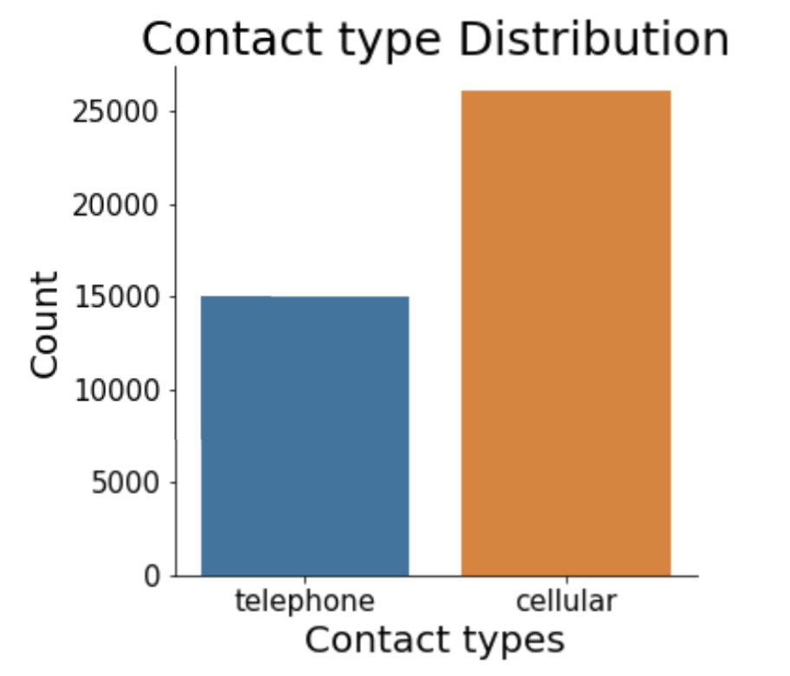
Take-aways
Encourage clients to choose cellular rather than telephone as communication type.

Slide 10
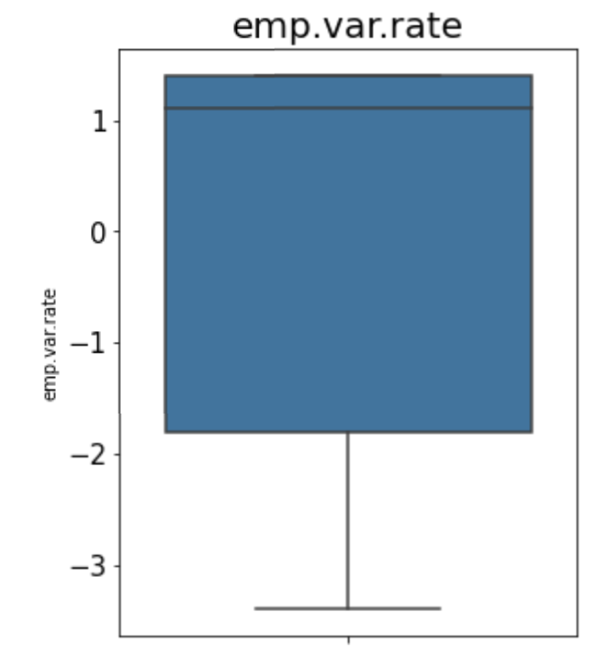
Take-aways
Negative employment variation rate (<-1.8) has positive impacts in our model.
The mean rate is 0.08

